Slide 1

British Airline
Predicting Customer Buying Behavior
Lachiket Warule
03/19/2025

Slide 2
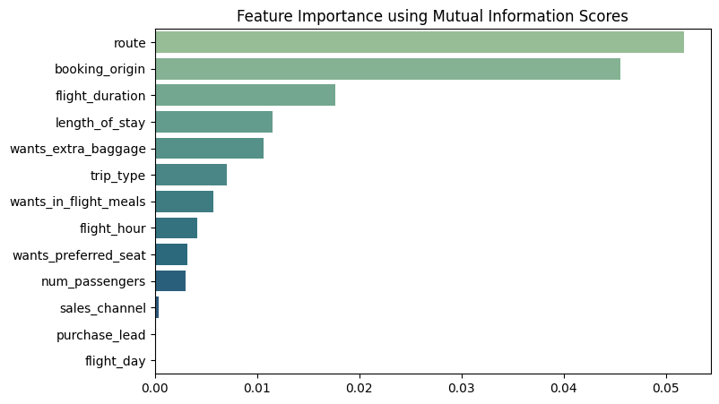
Predictive model to understand factors that influence buying behavior
We have trained the data set with Random Forest Classifier model and received
Training Accuracy: 99.82
Validation Accuracy: 85.03
Top 5 features which influence
Customer buying behavior:
route
booking_origin
flight_duration
length_of_stay
wants_extra_baggage

